Slide 1


Arrays in PHP
Arrays, Associative Arrays, Arrays Operations
Mario Peshev
Technical Trainer
http://peshev.net/
Software University
http://softuni.bg

Slide 2

Table of Contents
Declaring Simple PHP Arrays
Single-Dimensional Arrays
Associative Arrays
Multidimensional Arrays
Moreover...
Casting Arrays

Slide 3
Table of Contents (2)
Accessing arrays
Getting the size of an array
Looping through an array
Looping through an associative array
Examining arrays
Joining arrays
Sorting arrays
Sorting an associative arrays

Slide 4
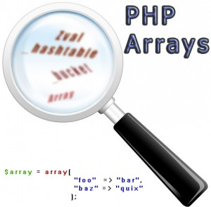
Declaring Simple PHP Arrays

Slide 5
What are Arrays?
An array in PHP is actually an ordered map. A map is a type that maps values to keys. This type is optimized in several ways, so you can use it as a real array, or a list(vector), hashtable(which is an implementation of a map), dictionary, collection, stack, queue, and probably more. Because you can have another PHP array as a value, you can also quite easily simulate trees.

Slide 6

Array Types
There are different opinions of whether PHP “really” supports different array types. The book says “yes”, defining the as indexed and Associative Arrays, based on whether the key is numeric or string
PHP.net says: “There are no different indexed and associative array types in PHP, there is only one array type, which can both contain integer and string indices.

Slide 7
So What’s a Key?
An array key can be thought of as the address or reference to a specific value contained within an array.
A key can be an integer or a string
Floats used as keys are truncated to integers
If you don’t specify a key, the array key will automatically start with 0 (zero) and auto increment by 1 each time a new value is entered into the array.
Key must be unique

Slide 8
Creating Empty Array
An array can be created by the array() language-construct.
As of PHP 5.4, can create array with []
<?php $newArray = array(); ?>
<?php $newArray = []; ?>

Slide 9
Creating initialization
An empty array can be created by the array() language-construct.
As of PHP 5.4, can create empty array with []
<?php $newArray = array(); ?>
<?php $newArray = []; ?>

Slide 10
Creating an Array
An array can be created by the array() language-construct. It takes a number of comma-separated key=>value pairs.
<?php
$student = array (
'firstName' => 'Pesho',
'lastName' => 'Georgiev',
'town' => 'Kaspichan');
?>
Value
Key

Slide 11
Accessing Array Elements
Array elements can be accessed using the array[key] syntax.
<?php
$array = array (
"foo" => "bar",
42 => 24);
echo $array['foo'] . '</br>';
echo $array[42];
?>

Slide 12

Declaring Simple PHP Arrays
Live Demo

Slide 13
Print Array Structure
You can quickly view the keys and values of an array using print_r()
<?php
$array = array (
"foo" => "bar",
42 => 24);
print_r($array);
?>
Array
(
[foo] => bar
[42] => 24
)

Slide 14
Even More Detail
You can quickly view structure, keys and values of an array using var_dump()
<?php
$array = array (
"foo" => "bar",
42 => 24);
var_dump($array);
?>
array(2) {
["foo"]=>
string(3) "bar"
[42]=>
int(24)
}

Slide 15
Add Items
After an array has been created, you can add values to the ‘end’ of the array
<?php
$array = array(
0 => "green",
1 => "yellow",
2 => 'blue');
$array[] = 'purple';
print_r($array);
?>
Array
(
[0] => green
[1] => yellow
[2] => blue
[3] => purple
)

Slide 16
Delete Array Element
After an array has been created, you can add values to the ‘end’ of the array:
<?php
$array = array(
0 => "green",
1 => "yellow",
2 => 'blue');
unset($array[1]);
print_r($array);
?>
Array
(
[0] => green
[2] => blue
)

Slide 17
Array size
You can count the number of values in an array:
<?php
$array = array(
"green", "yellow", 'blue', "purple", "grey");
echo count($array); // output 5
?>

Slide 18
Delete or Reset Array
You can delete all array:
unset($array);
If a globalized variable is unset() inside of a function, only the local variable is destroyed. The variable in the calling environment will retain the same value as before unset() was called.
Reset Array
$array = array();

Slide 19
Add and Remove
Live Demo

Slide 20

Looping Array

Slide 21
Looping through an array
Use for loop to process an array when
Need to keep track of the index
Processing is not strictly sequential from the first to the last element
In the loop body use the element at the loop index ($array[index]):
for() loop doesn't work on arrays with string indexes

Slide 22
Looping through an array Example
<?php
$array = array(
"green", "yellow", 'blue', "purple", "grey");
for($i = 0; $i < count($array); $i++){
echo $array[$i] . '</br>';
}
?>
green
yellow
blue
purple
grey

Slide 23
Looping through an associative array
There is a quick and easy way to accomplish the same thing: a foreach loop, which itself has two versions. The easiest way to use foreach looks like this:
<?php
$array = array(
"green", "yellow", 'blue', "purple", "grey");
foreach($array as $val) {
print $val."\n";
}
?>
green
yellow
blue
purple
grey

Slide 24
Looping through an associative array {2}
Here the array $array is looped through and its values are extracted into $val. In this situation, the array keys are ignored completely, which usually makes most sense when they have been auto-generated (i.e. 0, 1, 2, 3, etc).
<?php
$array = array(
"green", "yellow", 'blue', "purple", "grey");
foreach ($array as $key => $val) {
print "$key = $val\n";
}
?>
1 = yellow
2 = blue
3 = purple
4 = grey

Slide 25
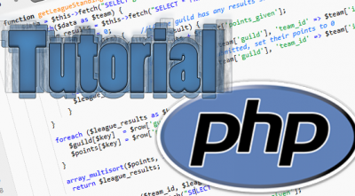
Looping Array
Live Demo

Slide 26

Build in Array Functions

Slide 27
Merge Arrays
Merges the elements of one or more arrays together so that the values of one are appended to the end of the previous one. It returns the resulting array
<?php
$array = array(
"green", "yellow", 'blue');
$other = array(
"purple", "grey");
$allTogether = array_merge($array, $other);
print_r($allTogether);
?>
Array
(
[0] => green
[1] => yellow
[2] => blue
[3] => purple
[4] => grey
)

Slide 28
Join Arrays
You can take colors and transform them into a string with implode() at the end of each color:
<?php
$array = array(
"green", "yellow", 'blue', "purple", "grey");
$newString = implode(", ", $array);
echo $newString;
?>
green, yellow, blue, purple, grey

Slide 29
Sorting Arrays
Arrays can be sorted by key or value
You can sort and keep keys aligned, or sort values and have new keys assigned.
sort() is alphabetical if values are string or numeric if values are number.
<?php
$array = array(
"green", "yellow", 'blue', "purple", "grey");
sort($array);
print_r($array);
?>
Array
(
[0] => blue
[1] => green
[2] => grey
[3] => purple
[4] => yellow
)

Slide 30
Reverse Sort
rsort() sorts in reverse:
<?php
$array = array(
"green", "yellow", 'blue', "purple", "grey");
rsort($array);
print_r( $array);
?>
Array
(
[0] => yellow
[1] => purple
[2] => grey
[3] => green
[4] => blue
)

Slide 31
Key sort
ksort() sorts keys, keeping values correlated to keys:
<?php
$array = array(
"green", "yellow", 'blue', "purple", "grey");
ksort($array);
print_r( $array);
?>
Array
(
[0] => green
[1] => yellow
[2] => blue
[3] => purple
[4] => grey
)

Slide 32
Shuffle array
shuffle() randomly reorganizes the order of the array:
<?php
$array = array(
"green", "yellow", 'blue', "purple", "grey");
shuffle($array);
print_r( $array);
?>

Slide 33
Extract Array
Use extract() to automatically create variables from an array, where the variables created are the keys and their values are the associated array values:
<?php
$array = array(
'color1' => "green",
'color2' => "yellow",
'color3' => 'blue',);
extract($array);
echo $color1; //Output green
echo $color2;//Output yellow
echo $color3; //Output 'blue
?>

Slide 34
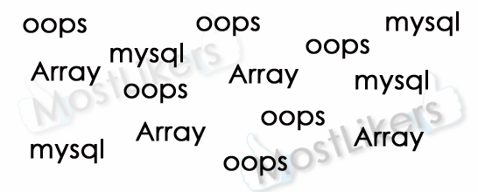
Build in Array Functions
Live Demo

Slide 35
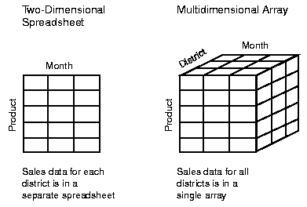
Multidimensional arrays

Slide 36
Multidimensional Arrays
A multidimensional array is an array containing one or more arrays.
The dimension of an array indicates the number of indices you need to select an element.
For a two-dimensional array you need two indices to select an element
For a three-dimensional array you need three indices to select an element

Slide 37
Multidimensional Arrays Example
<?php
$cars = array
(
array("Volvo",22,18),
array("BMW",15,13),
array("Saab",5,2),
array("Land Rover",17,15)
);
echo $cars[0][0].": In stock: ".$cars[0][1].", sold: ".$cars[0][2].".<br>";
echo $cars[1][0].": In stock: ".$cars[1][1].", sold: ".$cars[1][2].".<br>";
echo $cars[2][0].": In stock: ".$cars[2][1].", sold: ".$cars[2][2].".<br>";
echo $cars[3][0].": In stock: ".$cars[3][1].", sold: ".$cars[3][2].".<br>";
?>

Slide 38

Multidimensional arrays
Live Demo

Slide 39


Summary
Creating array
Looping arrays
For, Foreach
Build in array functions
sort(), ksort() shuffle(), merge, array_merge()
Multidimensional arrays
PHP & MySQL

Slide 40
PHP & MySQL
https://softuni.bg/trainings/fasttracks/details/1033

Slide 41
License
This course (slides, examples, demos, videos, homework, etc.) is licensed under the "Creative Commons Attribution-NonCommercial-ShareAlike 4.0 International" license
Attribution: this work may contain portions from
"PHP Manual" by The PHP Group under CC-BY license
"PHP and MySQL Web Development" course by Telerik Academy under CC-BY-NC-SA license

Slide 42





Free Trainings @ Software University
Software University Foundation – softuni.org
Software University – High-Quality Education, Profession and Job for Software Developers
softuni.bg
Software University @ Facebook
facebook.com/SoftwareUniversity
Software University @ YouTube
youtube.com/SoftwareUniversity
Software University Forums – forum.softuni.bg

